Slide 1
Inclement Weather and Affected Individuals
Big Data Project
Steven Nodalo

Slide 2
NEXRAD NOAA Dataset
Next Generation Weather Radar (NEXRAD)
National Oceanic and Atmospheric Administration (NOAA)
NEXRAD NOAA hosts publicly accessible, high-quality environmental and weather data in AWS S3 buckets
NEXRAD dataset is updated in 5-minute intervals from 160 radar stations around the US
Accessed using nexradaws Python module coupled with Boto3 Python SDK
Visual radar scans are viewed using cartopy

Slide 3
Thredds Data Server
Web server that provides metadata for NEXRAD dataset
Uses OpeNDAP, OGC, WMS, WCS, and HTTP
Provides virtual directories of data and metadata
Data is contained in CSV, XML and WaterML
Enhances NEXRAD radar scans by providing animated and in-depth views
Accessed using siphon Python utilities
Visual enhancements and metadata are viewed using cartopy

Slide 4
Twitter Dataset
Contains user Tweets based off geo-location, keywords and time/date
Provides further enhancement to NEXRAD data
Accessed using TweePy Python module
Implemented using Python pandas data analysis tool

Slide 5
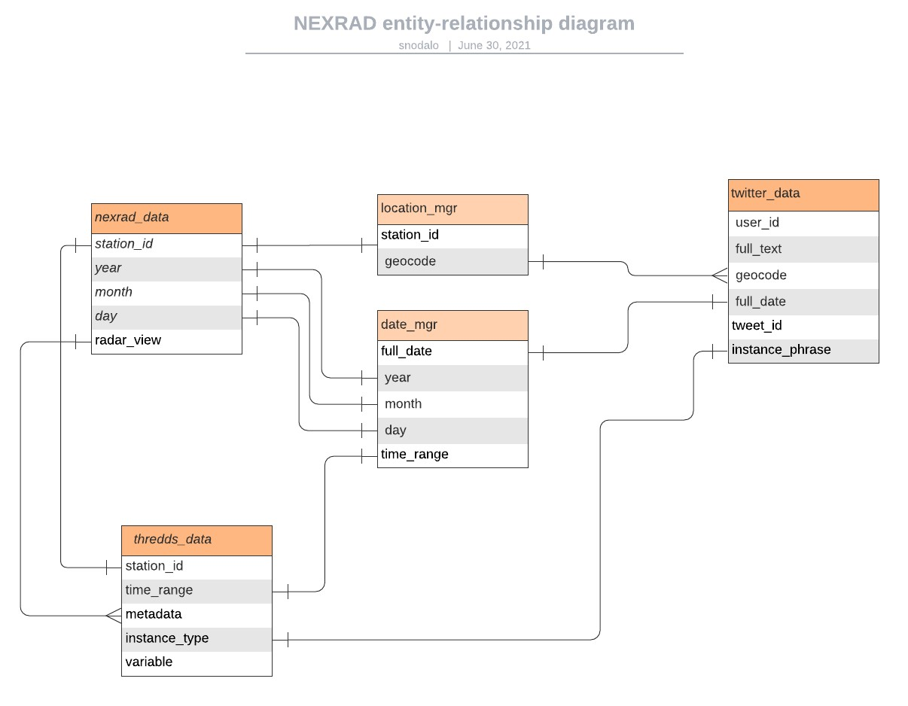
Entity-Relationship Diagram

